Slide 1
CS583 Probabilistic Graphical Models
Lecture 21. Special Forms of Conditional Probability Distribution
Oleksandr Narykov
onarykov@iit.edu

Slide 2
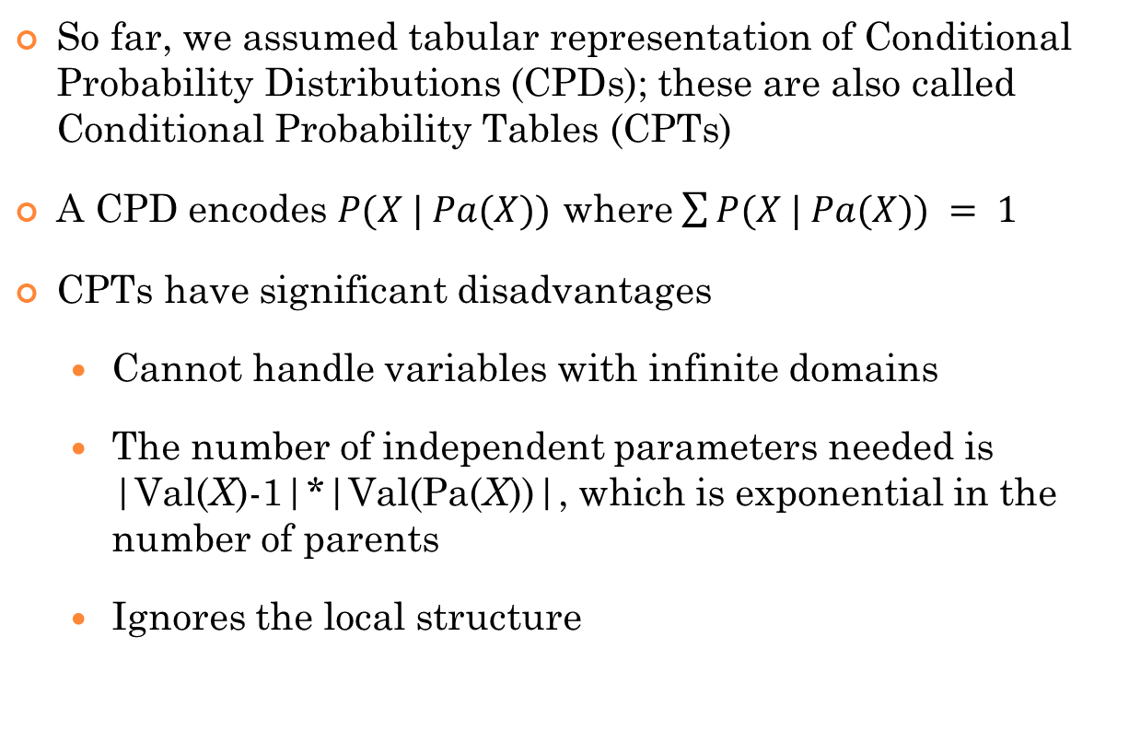
CPDs
So far, we assumed tabular representation of Conditional Probability Distributions (CPDs); these are also called Conditional Probability Tables (CPTs)
A CPD encodes $P(X | Pa(X))$ where $\sum{P(X | Pa(X))} = 1$
CPTs have significant disadvantages
Cannot handle variables with infinite domains
The number of independent parameters needed is |Val(X)-1|*|Val(Pa(X))|, which is exponential in the number of parents
Ignores the local structure

Slide 3
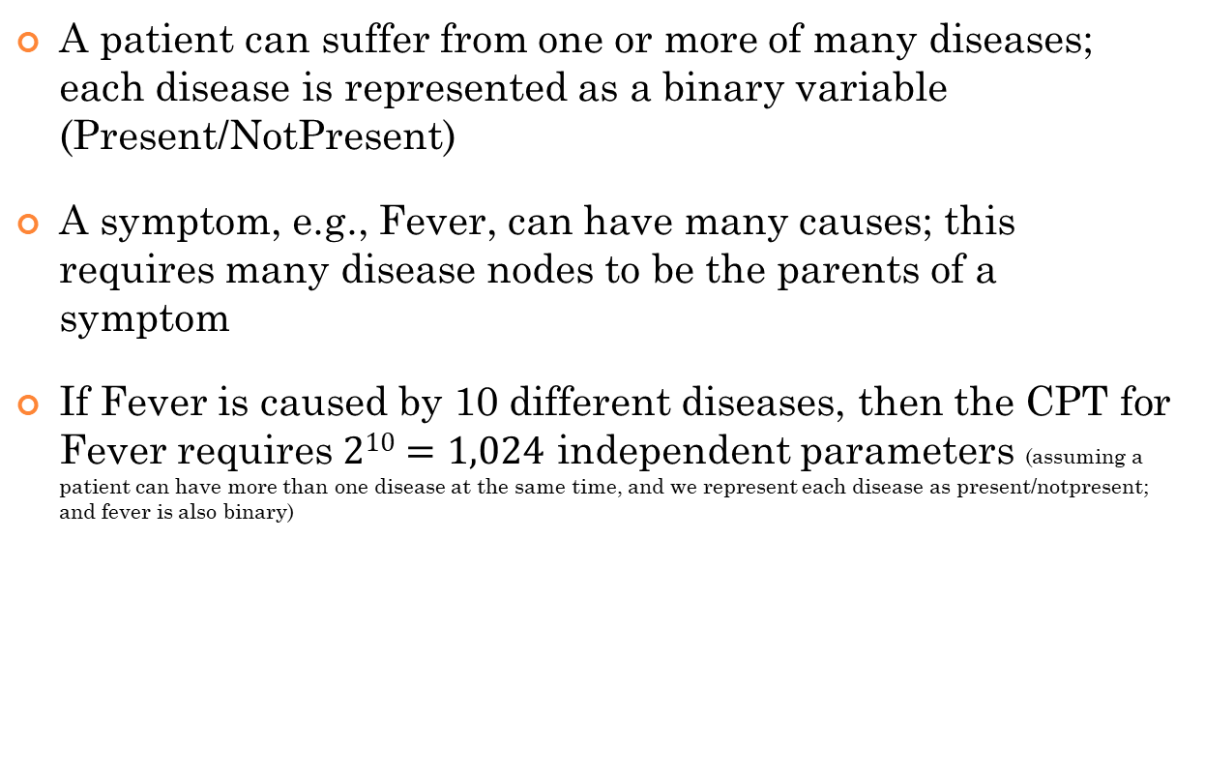
Example – Medical diagnosis
A patient can suffer from one or more of many diseases; each disease is represented as a binary variable (Present/NotPresent)
A symptom, e.g., Fever, can have many causes; this requires many disease nodes to be the parents of a symptom
If Fever is caused by 10 different diseases, then the CPT for Fever requires $210=1,024$ independent parameters (assuming a patient can have more than one disease at the same time, and we represent each disease as present/notpresent; and fever is also binary)

Slide 4
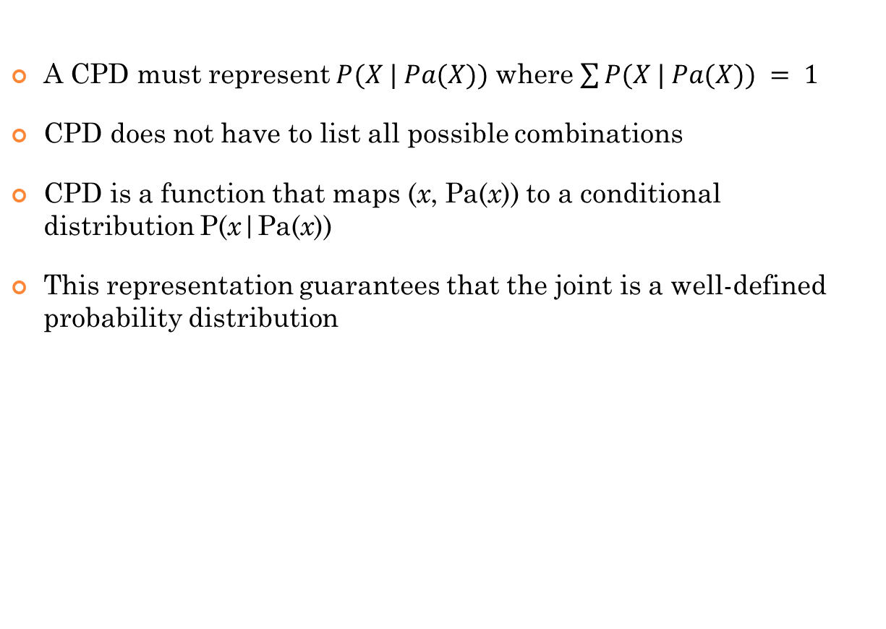
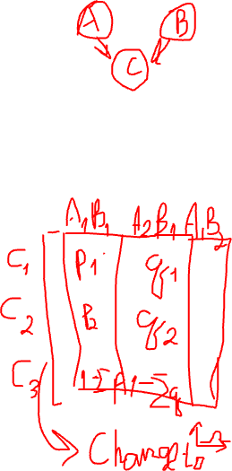
Key Insight
A CPD must represent $P(X | Pa(X))$ where $\sum{P(X | Pa(X))} = 1$
CPD does not have to list all possible combinations
CPD is a function that maps (x, Pa(x)) to a conditional distribution P(x|Pa(x))
This representation guarantees that the joint is a well-defined probability distribution

Slide 5
Types of cpds we will discuss
Deterministic CPDs
Context-Specific CPDs
Tree CPDs
Rule CPDs
Causal independence
The noisy-or model
Logistic CPD
Continuous variables
Linear Gaussian CPDs

Slide 6
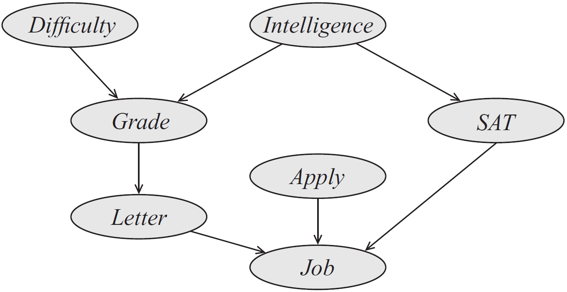
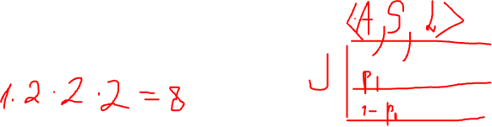
Example: job application
Industrious
Notes:
If you don’t apply, there is still a chance they might offer you a job (they are desperate). If you don’t apply, they don’t have your SAT score and recommendation letter.
If you apply, they look at your SAT score first and if it is high, they make their decision. Otherwise, they look at your recommendation letter.

Slide 7
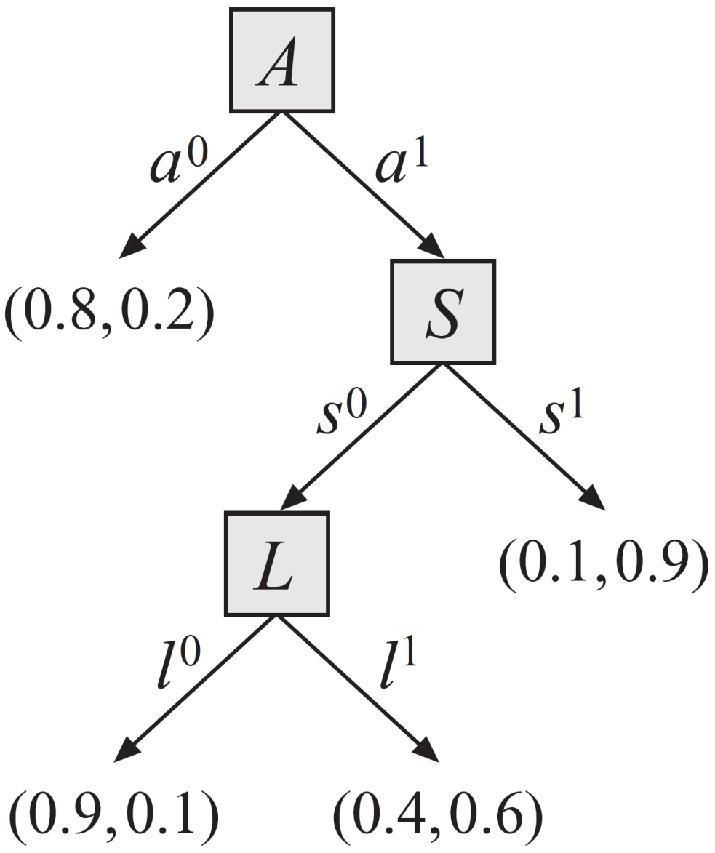
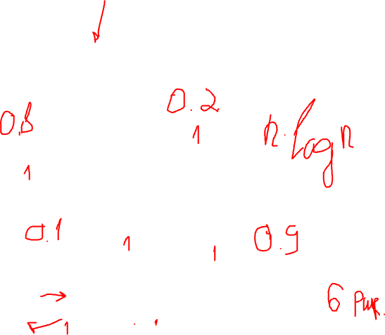
Tree-cpds
How many independent parameters are needed?
Notes:
1x2x2x2=8
If you don’t apply, there is still a chance they might offer you a job (they are desperate). If you don’t apply, they don’t have your SAT score and recommendation letter.
If you apply, they look at your SAT score first and if it is high, they make their decision. Otherwise, they look at your recommendation letter.

Slide 8
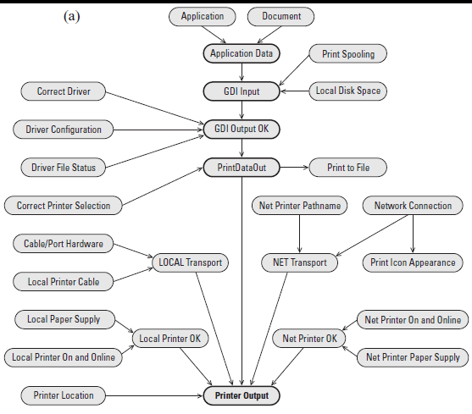
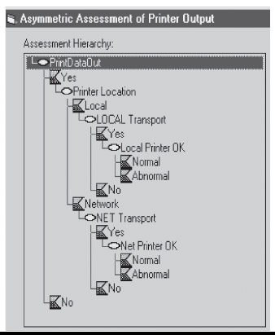

Slide 9
Rule cpds
Definition: A rule-based CPD P(X|Pa_{X}) is a set of rules R such that
For each rule r∈R, Scope[r] ⊆ {X} ∪ Pa_{X}
For each assignment to (x, u), we have precisely one rule <c;p>∈R such that c is compatible with (x, u). In this case, P(X=x | Pa_{X} =u) = p.
The resulting CPD P(X|Pa_{X}) is a legal CPD,
Σ_{x} P(x |u) = 1
More general than tree CPDs
Every tree CPD can be represented as a rule-based CPD but the converse is not true

Slide 10
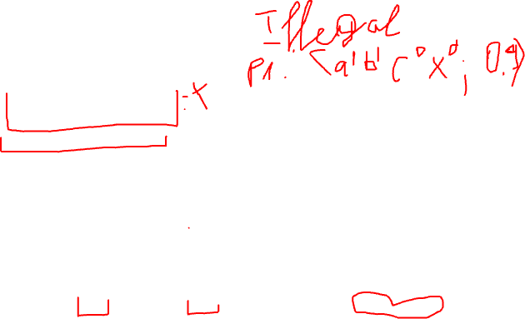
Example: rule cpds

Slide 11
Independence of causal models
Variable of interest Y depends on several causes X₁, …, X_{k}
Even though the interaction between X_{i} and Y can be arbitrary, it is often reasonable to assume that the combined influence of X_{i} on Y is a simple combination of the individual influences of X_{i} on Y in isolation.
Noisy-or model
Logistic CPD

Slide 12
Noisy-or Model
A professor writes a good letter if
The student asked good questions in class, or
The student wrote a good final paper
However, the professor
Might forget that student asked good questions, with 0.2 probability
Might not be able to read student’s handwriting, with 0.1 probability
What is the probability that the professor will write a good letter if the student
Did not ask good questions, and did not write a good final paper?
Asked good questions but did not write a good final paper?
Did not ask good questions but wrote a good final paper?
Asked good questions, and wrote a good final paper?

Slide 13
Noisy-or model
Q, F | l⁰ | l¹
q⁰,f⁰ | 1 | 0
q⁰,f¹ | 0.1 | 0.9
q¹,f⁰ | 0.2 | 0.8
q¹,f¹ | ? | ?
For the professor to write a bad letter when student asked good questions and a good final paper, the professor
Forgets the student’s participation AND
Cannot read the student’s handwriting
P(l⁰|q¹,f¹) = 0.1*0.2 = 0.02
P(l¹|q¹,f¹) = 1 – 0.02 = 0.98
Notes:
P(L|Q,F)

Slide 14
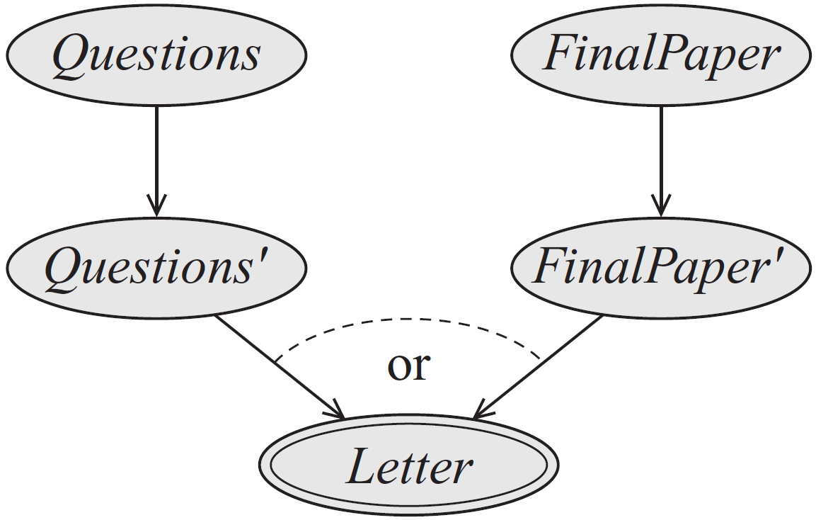
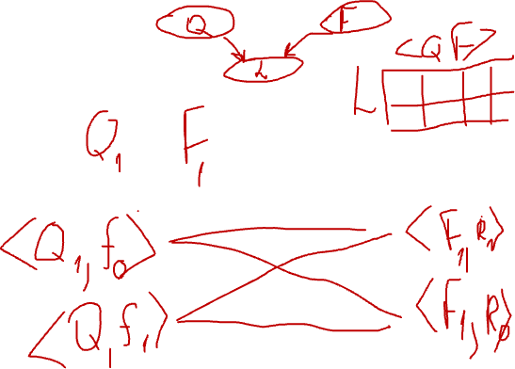
Noisy-or model
Notes:
A professor writes a good letter if the student asks questions in the class or writes a good final paper. However, the professor might not remember the student’s participation or might not be able to read his handwriting.

Slide 15
Noisy-or model
Let Y be a binary random variable with k binary parents X₁, …, X_{k}. The CPD P(Y| X₁, …, X_{k}) is a noisy-or if there are k+1 parameters λ₀, λ₁, ..., λ_{k} such that

Slide 16
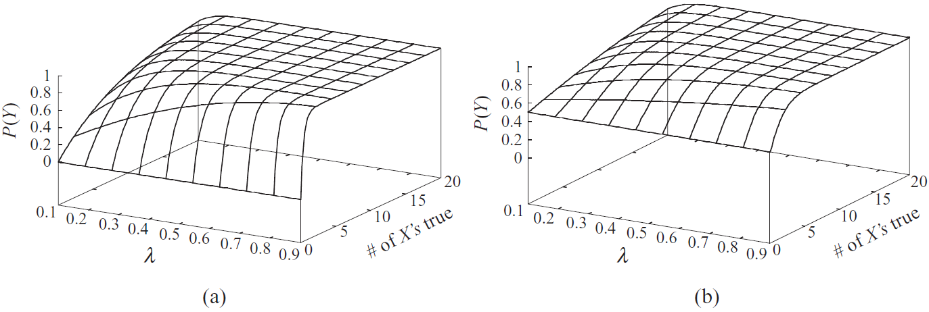
Noisy-or model
Notes:
(a): the leak prob is 0. (b): the leak prob is 0.5.

Slide 17
Logistic cpd
Let Y be a binary variable with k parents: X₁, …, X_{k} that take on numerical values. The CPD P(Y| X₁, …, X_{k}) is a logistic CPD if there are k+1 weights w₀, w₁, …, w_{k} such that

Slide 18
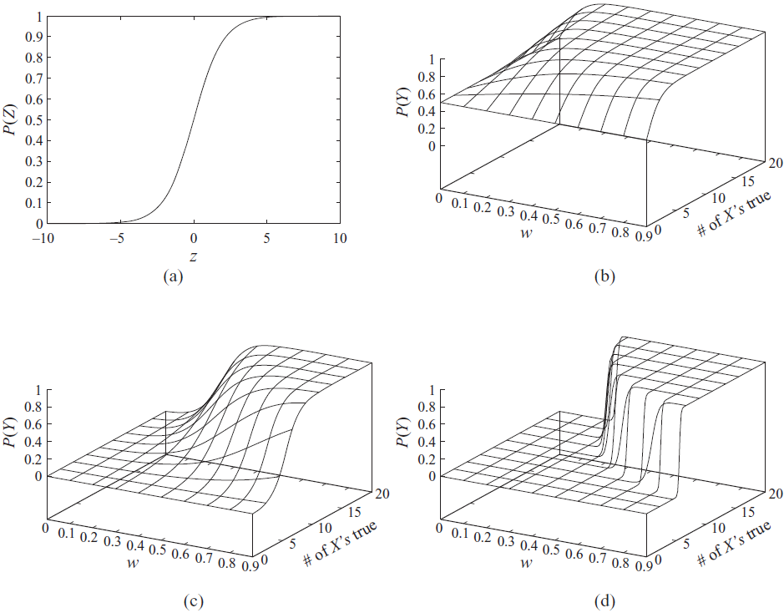
Logistic cpd
Notes:
(a). The logistic function. (b) w0 = 0 (c) w0 = -5 (d) w0 and w are multiplied by 10

Slide 19
Linear gaussian cpd
Let Y be a continuous variable with continuous parents X₁, … , X_{k}. We say that Y has a linear Gaussian model if there are parameters β₀, ..., β_{k} and σ² such that

Slide 20
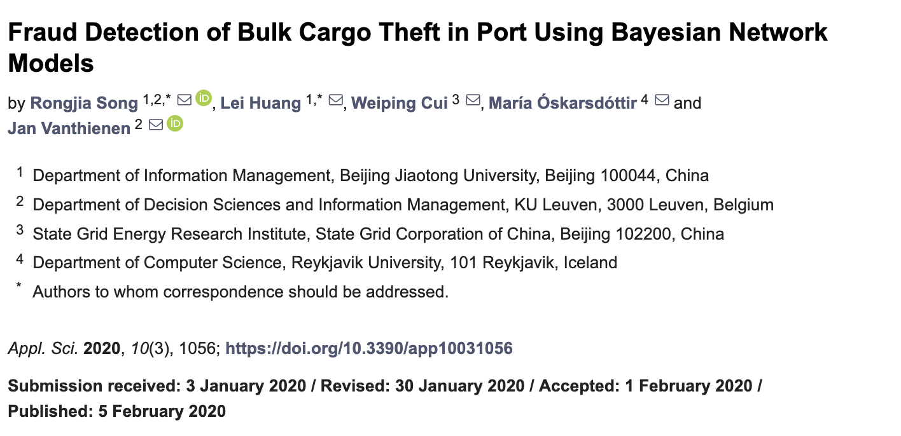
Fraud Detection of Bulk Cargo Theft in Port

Slide 21
Fraud Detection of Bulk Cargo Theft in Port
ID | Event Description
1 | On the night of 14 March 2014, driver Zhou drove the truck with plate number XiangX. He stole 3.88 tons of brown coal (Indonesia coal, Lower Heating Value: 4400 Kcal/Kg) from terminal A of Guangzhou Port by reforming or retrofitting the water tank of the truck. The truck came into the terminal A with water in the tank and released the water before loading. Then he secretly transported the stolen cargo, identified to have a value of 455 yuan per ton and 1765.4 yuan in total, to the factory B in DongGuan.
2 | On the night of 11 April 2014, driver Cao drove the truck with plate number YueY, and stole 3.89 tons of coal (Indonesian Steam Coal, Lower Heating Value: 4651 Kcal/Kg) from terminal C of Guangzhou Port by reforming the car hopper of the truck. The truck came into the terminal C with objects in the car hopper and that were released before loading. Then he secretly transported this cargo from the theft, identified to have a value of 518 yuan per ton and 2011.3 yuan in total, to the factory D in DongGuan.
Song, Rongjia, et al. "Fraud detection of bulk cargo theft in port using bayesian network models." Applied Sciences 10.3 (2020): 1056

Slide 22
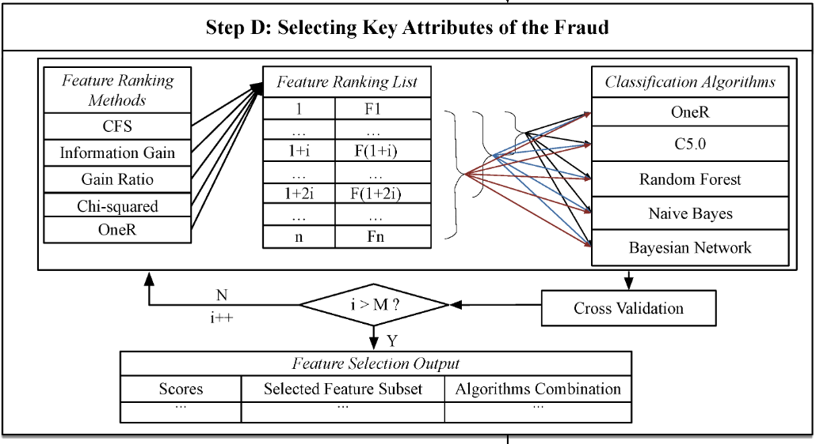
Fraud Detection of Bulk Cargo Theft in Port

Slide 23
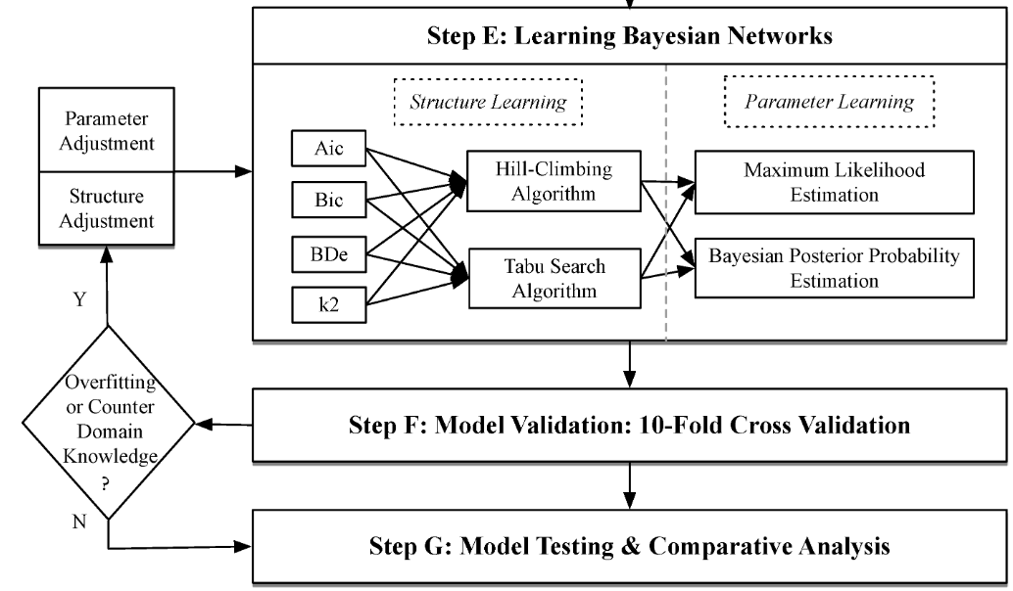
Fraud Detection of Bulk Cargo Theft in Port

Slide 24
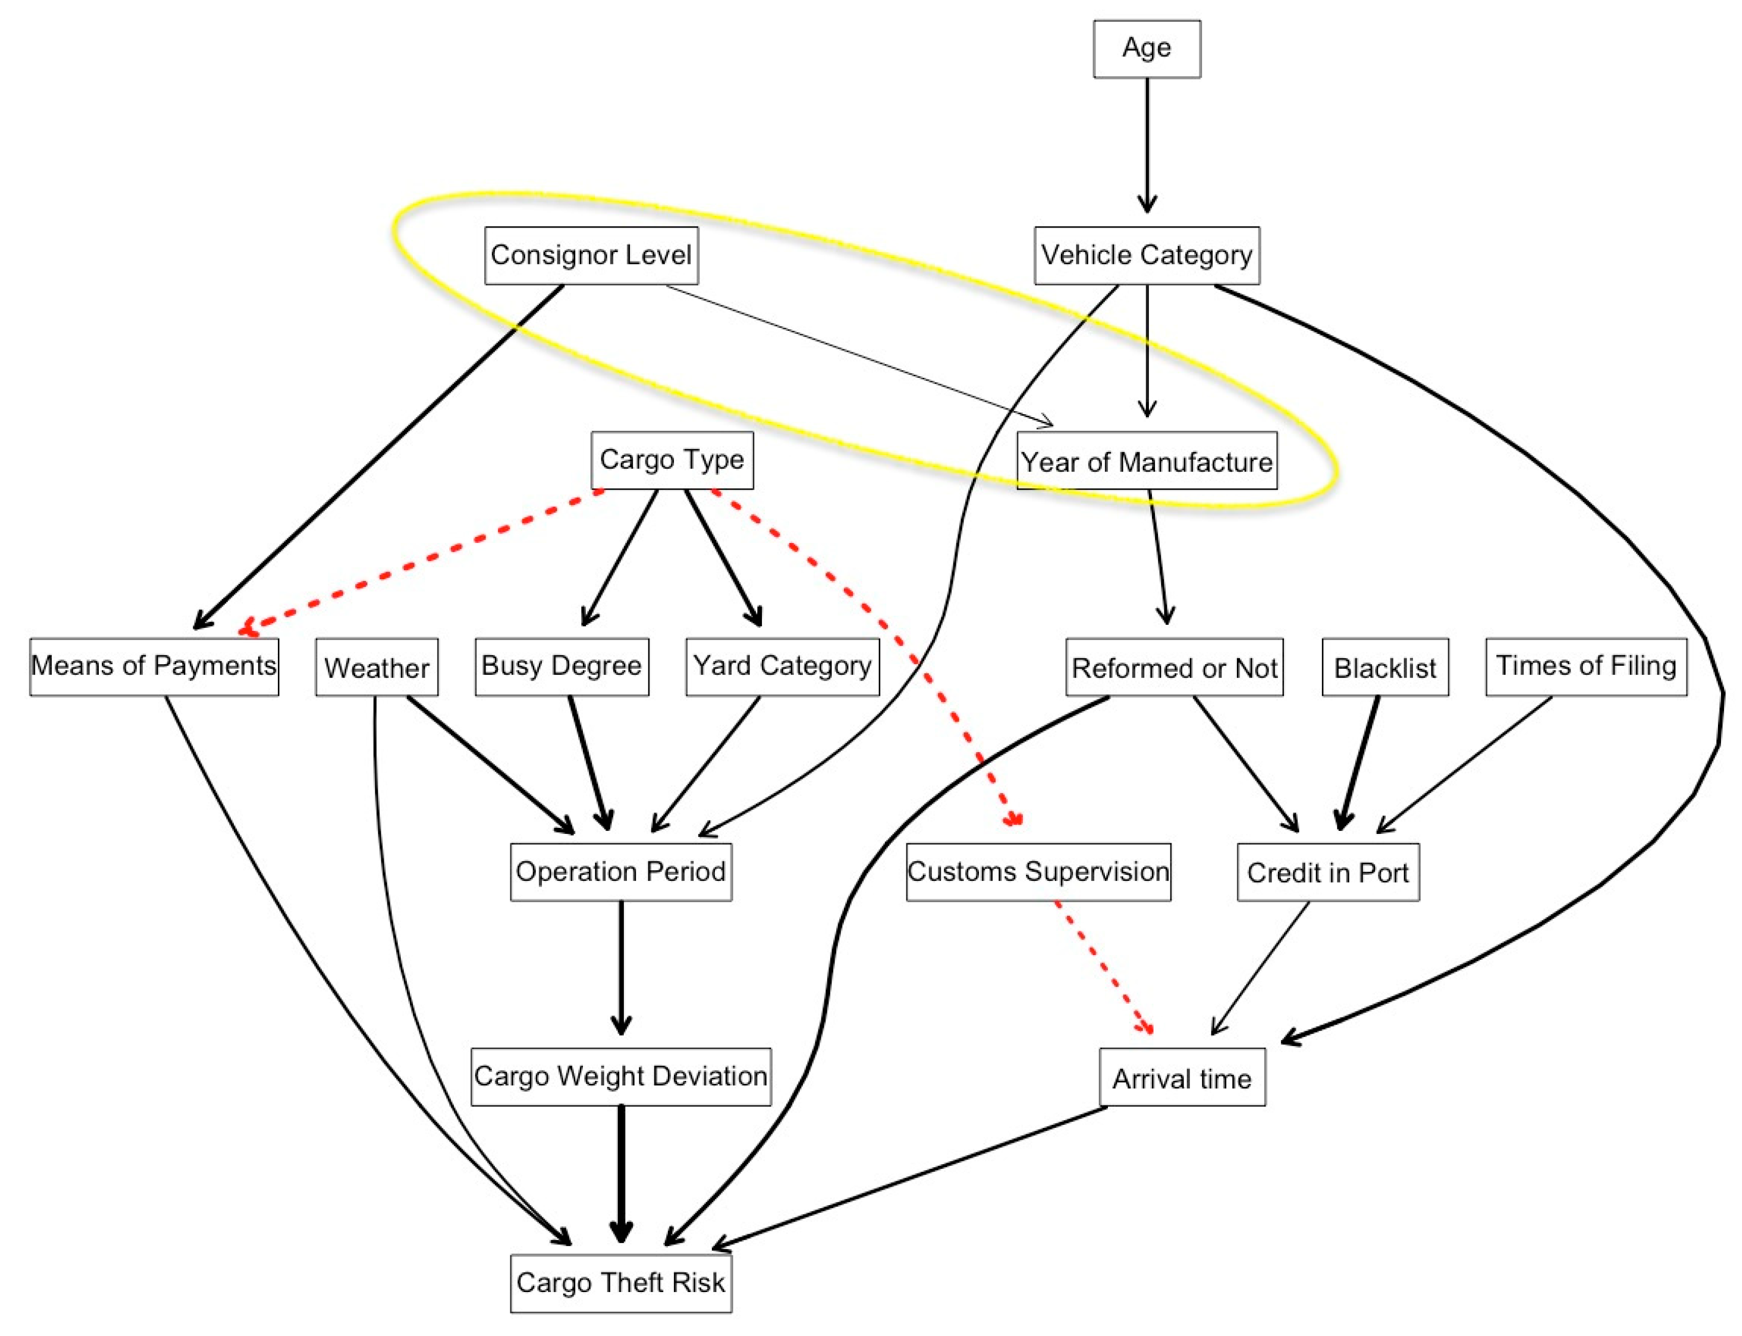
Fraud Detection of Bulk Cargo Theft in Port
Tabu search results

Slide 25
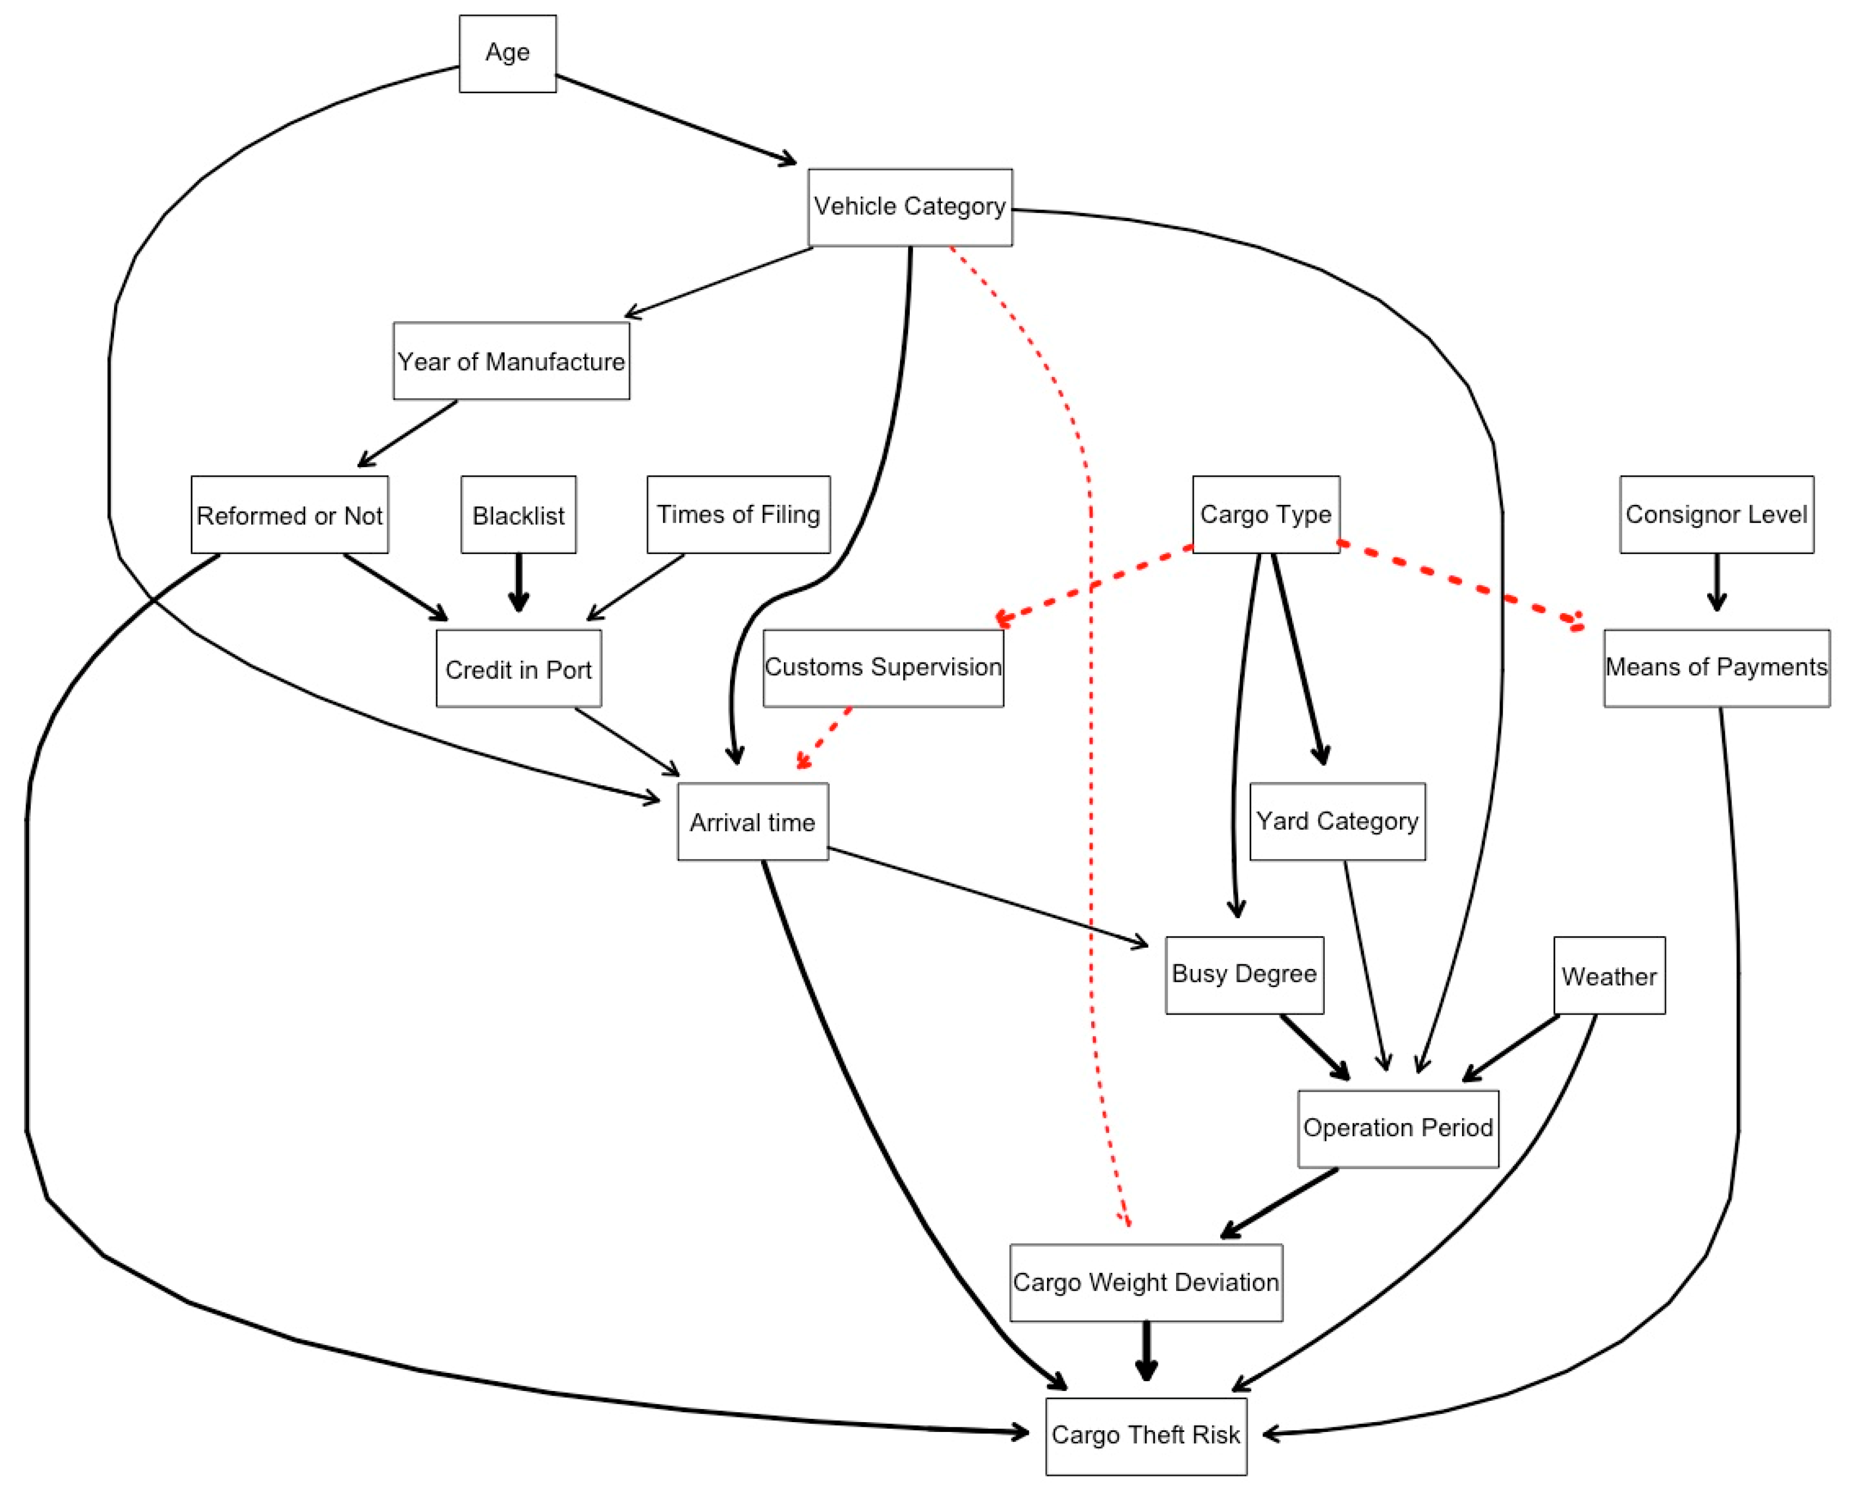
Fraud Detection of Bulk Cargo Theft in Port
Hill Climb algorithm results

